Slide 1
From shame to favour
1 Samuel 1

Slide 2
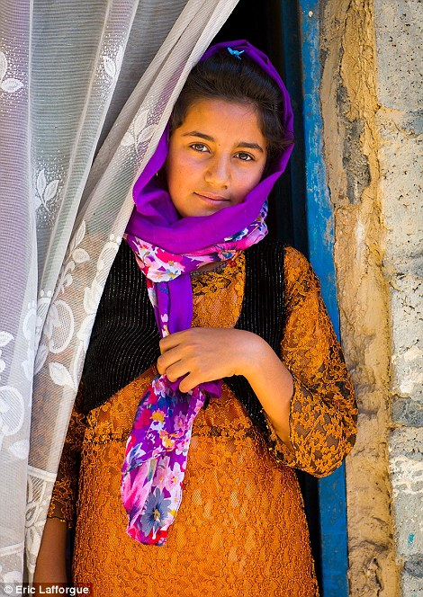
Who is Hannah?
Childless…
Security, identity, future, value in society all at stake
Stigmatised and provoked
Hannah feels replaced and forgotten
In 1 Samuel 1, she is the main character
We are invited to learn from her and her story

Slide 3
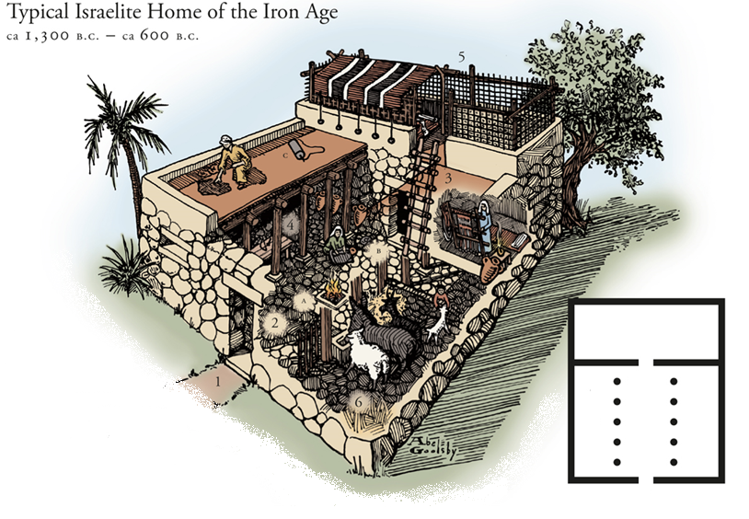
Hannah’s world
Sister wives
Patriarchal culture
Nazirites
Shiloh
Daily life
(& the impossible Mrs Proverbs 31)

Slide 4
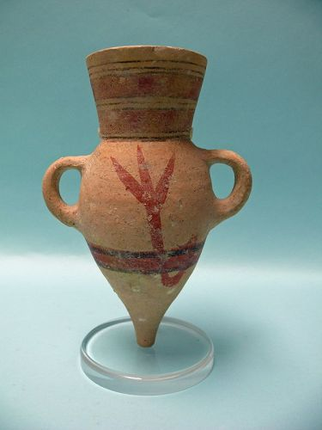
Identifying shame in the text
Brené Brown:
Shame is the intensely painful feeling or experience of
believing we are flawed
and therefore
unworthy of acceptance and belonging
Shame leaves us feeling
Trapped Powerless Isolated

Slide 5
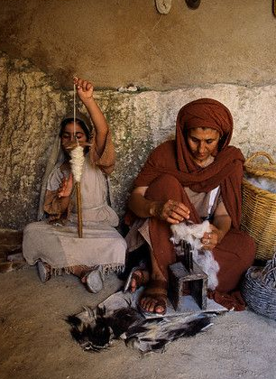
Vulnerability & dependence
Hannah’s shame and circumstances contain two elements:
How she sees herself
How she thinks others see her
In her vulnerability, Hannah has nowhere to go but to God, depending on His power and grace.
From trapped to freed
From powerless to empowered
From isolated to remembered
Not every detail of her circumstances changes, but God remembers Hannah and gifts her with a new situation.

Slide 6
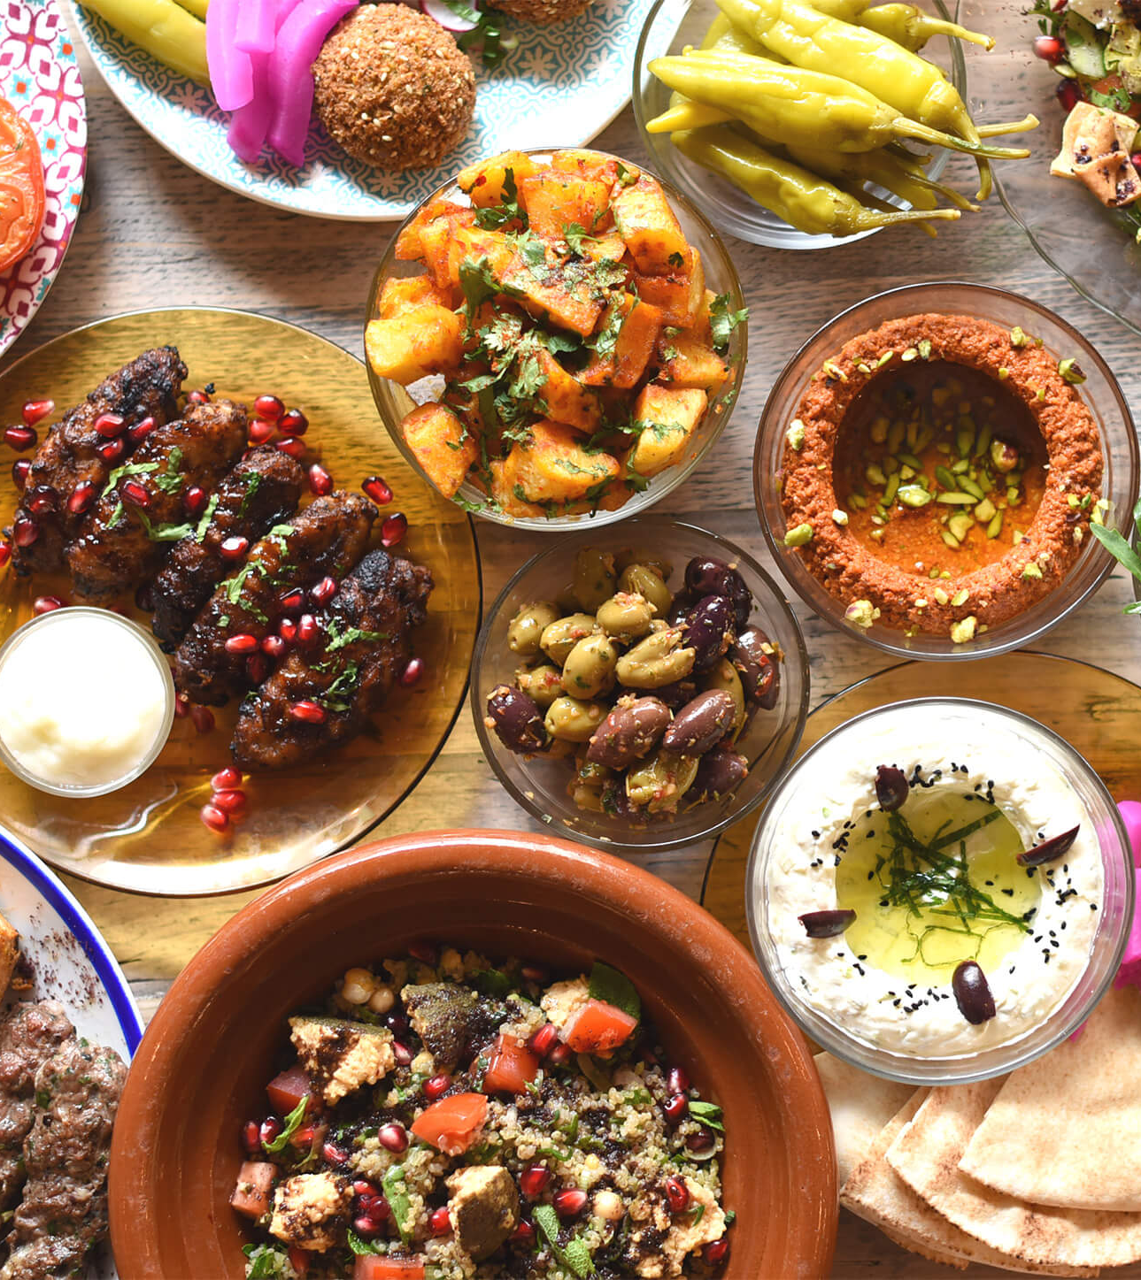
Who does God favour?
Man looks at the outward appearance, but the LORD looks at the heart 1 Samuel 16:7
Consistently in the Bible, God favours the underdog, the outsider, the shamed and the least significant: those who humble themselves and depend utterly on him
You prepare a table before me in the presence of my enemies
Psalm 23:5

Slide 7
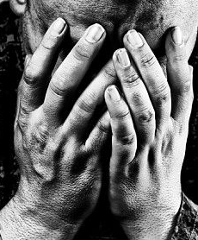
Making it personal
Shame is a part of many of our stories
God understands shame, meets us at the dung-heap and transforms us
We have testimonies of God’s redemption from feeling trapped, powerless and isolated
God gives us a new direction, a new perspective; nothing is wasted

Slide 8
Our self-perceptions
Do you have a healthy self-view?
If you are impacted by shame, God wants you to know this:
‘The Lord himself goes before you and will be with you; he will never leave you nor forsake you. Do not be afraid; do not be discouraged.’
Deuteronomy 31:8
If you need to pray with others, please contact someone in the church to talk and pray with.
Resolve to act, don’t dwell on the dung-heap!

Slide 9
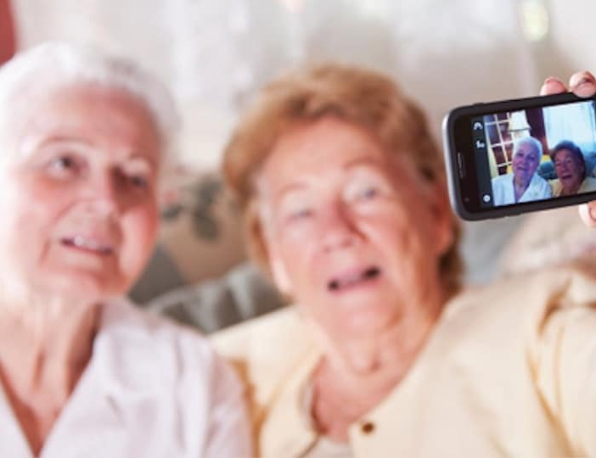
What does this mean for how we perceive others?
Be less Eli, more Jesus…
Be gracious with everyone
Look out for and remember others
Accept people who differ from you
Listen and learn
Be part of the healing process
Cultivate an environment where all can belong and be blessed
Be intentional in all this

Slide 10
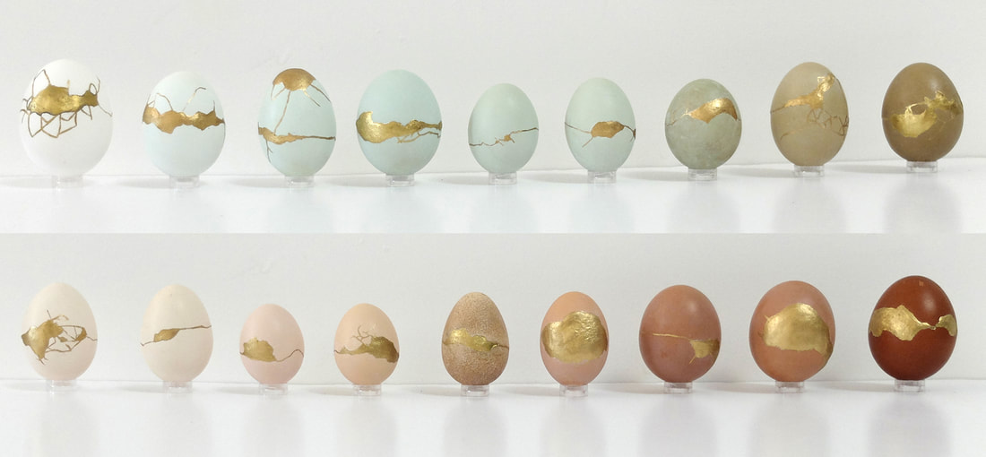
What can we all learn?
Don’t be afraid of your ‘flaws’
Allow God to heal and redeem – he alone has the power to invert situations
Does God want to use HBC to restore others?
Who needs God’s favour?

Slide 11
Hannah’s song
God is not only Powerful, but full of Grace
He raises the poor from the dust
and lifts the needy from the ash heap;
he seats them with princes
and makes them inherit a throne of honour.
1 Samuel 2:8

