Slide 1
Samuel
A life well lived in difficult times
3. A life of service 1 Samuel 7

Slide 2
1 Samuel
Chapters 1-3
The birth of Samuel
Chapters 4-6
The ark narratives
The folly of relying on religious symbols to guarantee victory
Chapter 7
Samuel as Judge

Slide 3
Background
The Promised Land
Had people in it beforehand but God wanted to replace them because of their wickedness (Dt 9:4)

Slide 4
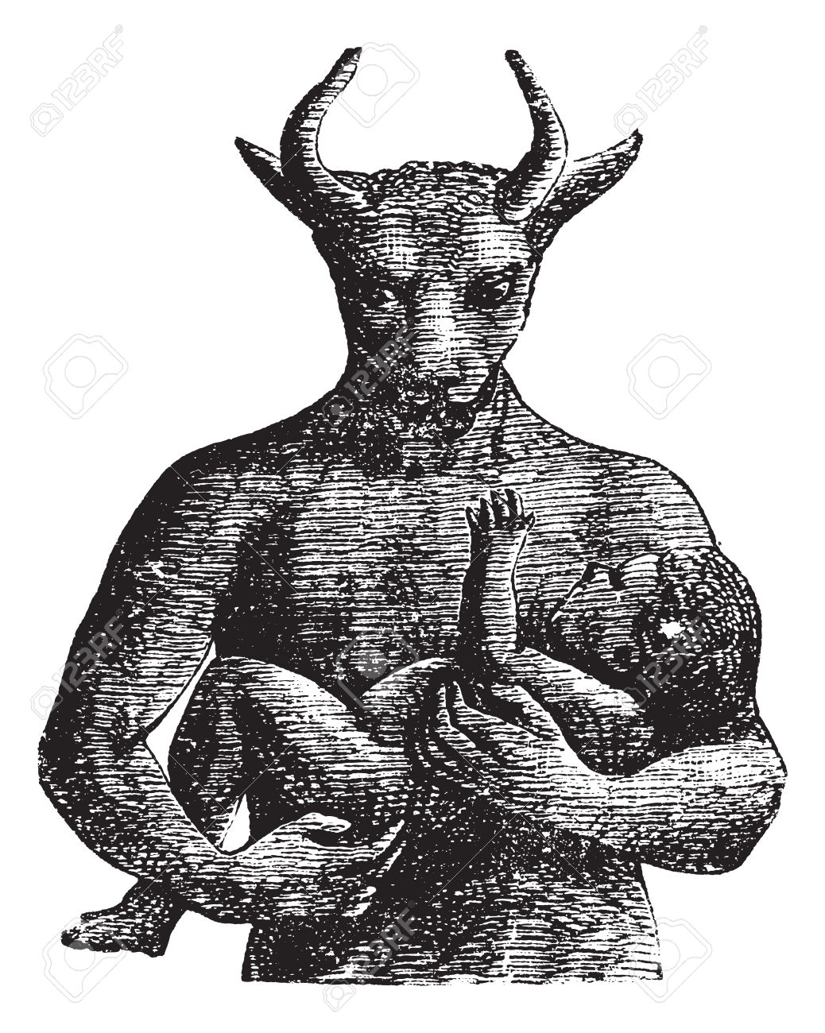
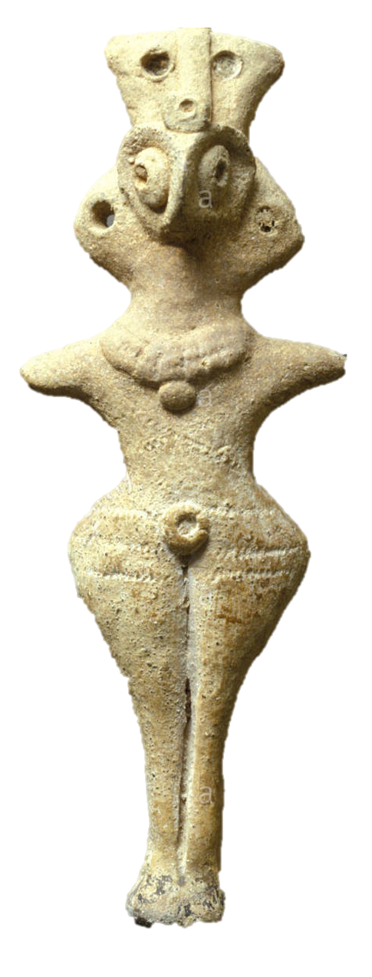
Baal (bull)
Asherah
Ashtorah
(owl)
Molech

Slide 5
Background
The Promised Land
Had people in it beforehand but God wanted to replace them because of their wickedness (Dt 9:4)
It was a battle to take the land completely
Joshua, Judges and Samuel record these battles
In chapter 7 we see how Samuel handled it
With prayer and faithful service to God

Slide 6
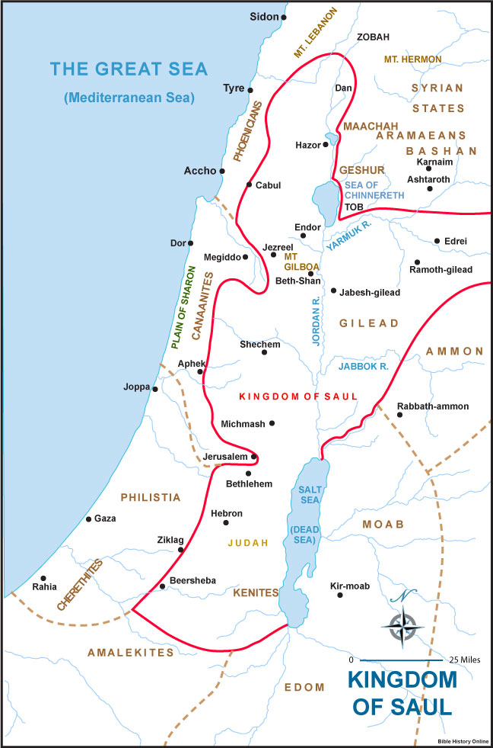
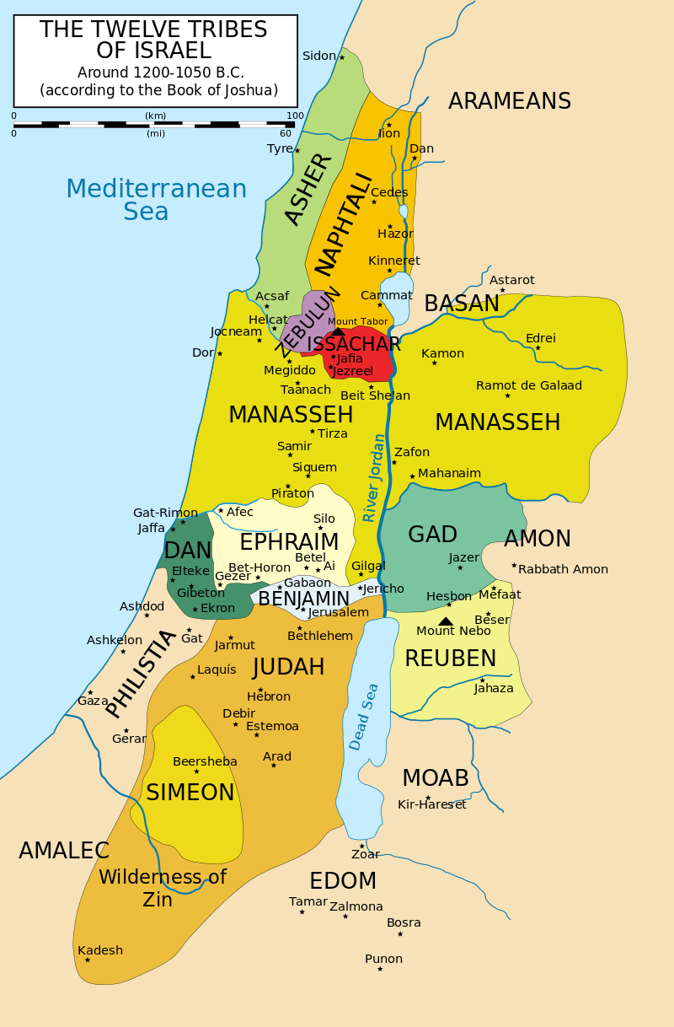
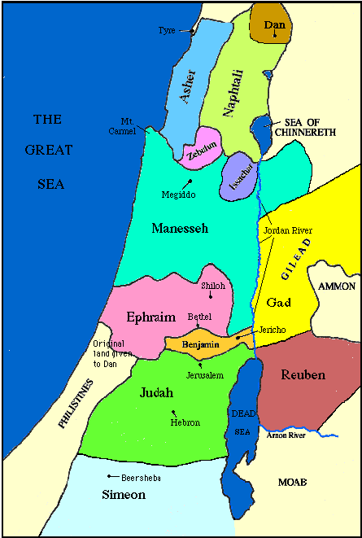
Phoenicians

Slide 7
Background
The Promised Land
Had people in it beforehand but God wanted to replace them because of their wickedness (Dt 9:4)
It was a battle to take the land completely
Joshua, Judges and Samuel record these battles
In chapter 7 we see how Samuel handled it
With prayer and faithful service to God

Slide 8
Samuel served by being the ‘judge’
The deliverer of God’s wisdom
A leader of people
The anointed person who kept the relationship between God and his people right
He helped them engage with God
He prayed for them
He demonstrated what faith could do
He reminded people of God’s actions

Slide 9
Samuel served through routine
It was a local ministry which had some influence

Slide 10
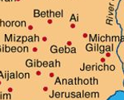
Ramah

Slide 11
Samuel served through routine
It was a local ministry which had some influence
The decline of his ministry had national and historical significance

Slide 12
How do we serve God?
By praying
By setting up reminders of God’s blessing
By leading people towards God
By speaking into their lives
But not by being judgemental
God wants your wholehearted commitment

