Slide 1
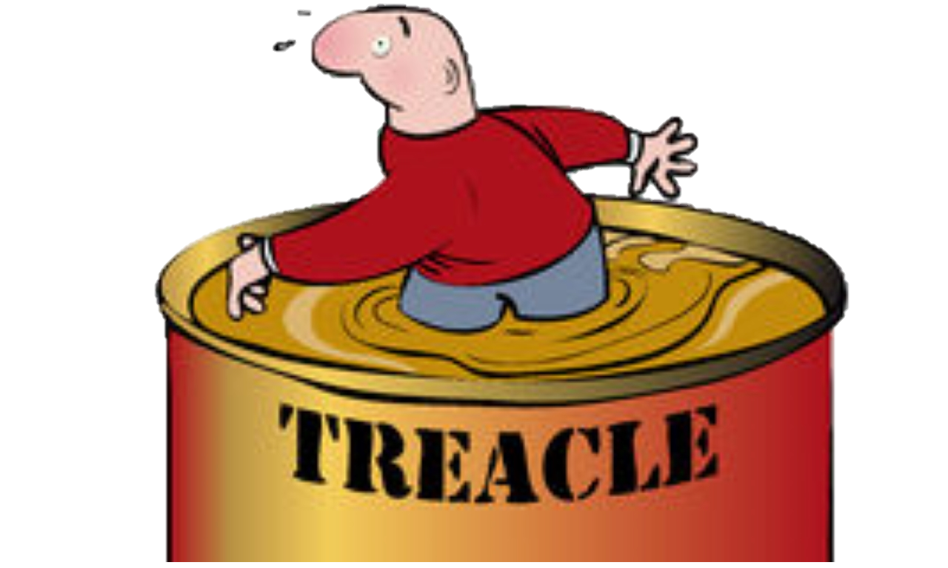
Walking through treacle
7. Keep the goal in mind
2 Corinthians 4:7-5:21

Slide 2
Life can be harsh
Natural disasters
Suffering in the body, physical decay
Judgment
By society
By individuals
By God

Slide 3
There is a Christian answer!
In chapters 4 & 5 of 2 Cor Paul tackles the common problems of life:
Suffering and physical decay (4:7-18)
Death (5:1-9)
Judgement (5:10-21)
Paul grabs all of these issues and puts them under the light of Christ in us, the hope of glory
His answer is not to exercise more or to make ourselves more useful or volunteer more to try to stave off the evil day

Slide 4
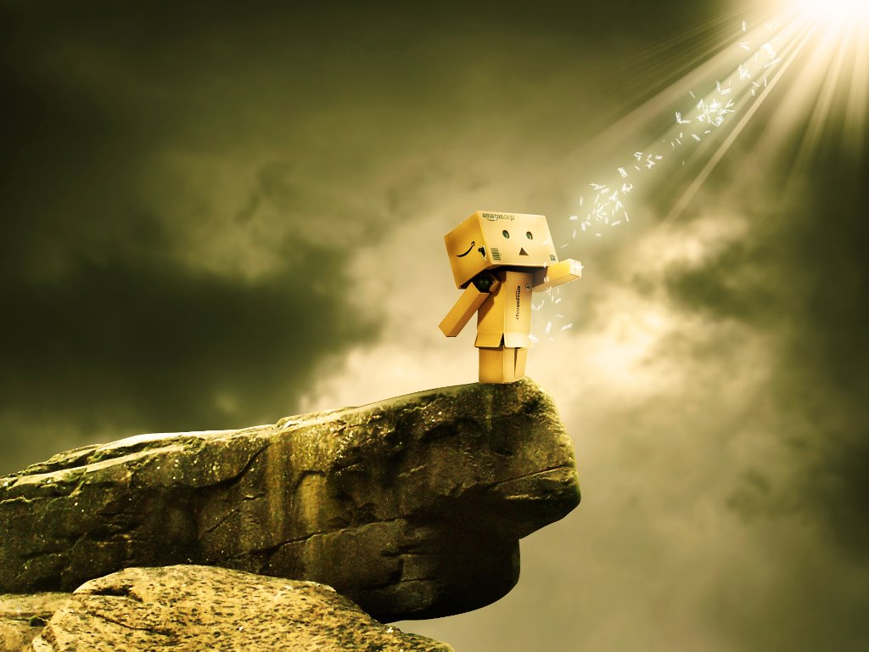
God wants you to see it how it is
5 contrast themes to describe the Christian life and outlook
Light in darkness
Power in weakness
Life in death
Faith in silence
Glory in suffering
All of these remind us that this world is not our home

Slide 5
The glory is yet to come
This is living with eternity in mind
This world is not my home – I’m just passing through!
Age will get to me, but it doesn’t define who I am
The world may judge me on what I am worth to them but God loves me unreservedly because of the treasure within

Slide 6
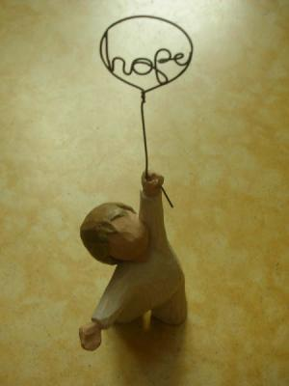
One day…
We’ll see…
God’s plan is perfect
We’ll understand…
Weakness is a strength
We’ll value…
People differently
We’ll understand…
Sacrificing for love

