Slide 1
Applying the Covenant
10. Deuteronomy 24:1-25:4 Making a fair society

Slide 2
God has a plan for people
To become as He intended
To be included, accepted and loved
To be part of a society that deals with difficulties
He has gone to great lengths to make that happen
including letting us know who He is, why He created us, what He wants from us and dealing with our shortcomings through the death of His Son on the cross
His plan does NOT include us becoming pain-free
When we choose Christ we are not choosing an easy life
That plan includes us showing the world an alternative way of life as a community
Based on love

Slide 3
God’s grace and love to overflow to ALL
If you think you can put God in a box and bring Him out on Sundays then you’ve missed the point
The covenant tells us that God is relational
He’s a boundary maker
The covenant tells us God is communal
He brings people together in Christ that we might reflect God’s community of the Trinity
At the heart of the Trinity there is pain

Slide 4
God wants a His community to reflect His love
A society that shows the world how to live with pain
The pain of intimate relationships
The pain of debt
The pain of being taken advantage of
The pain of a disease
The pain of keeping offenders in society
This section deals with all of that and animal welfare

Slide 5
A society that nurtures and protects
Women in broken marriages (24:1-4)
The newly married (5)
Those who fall into debt (6,10-13,17)
The vulnerable (7)
The community from the spread of disease (8,9)
The employee (14,15)
The innocent (16)
The weak (17-22)
The offender (25:1-3)
Animals (25:4)

Slide 6
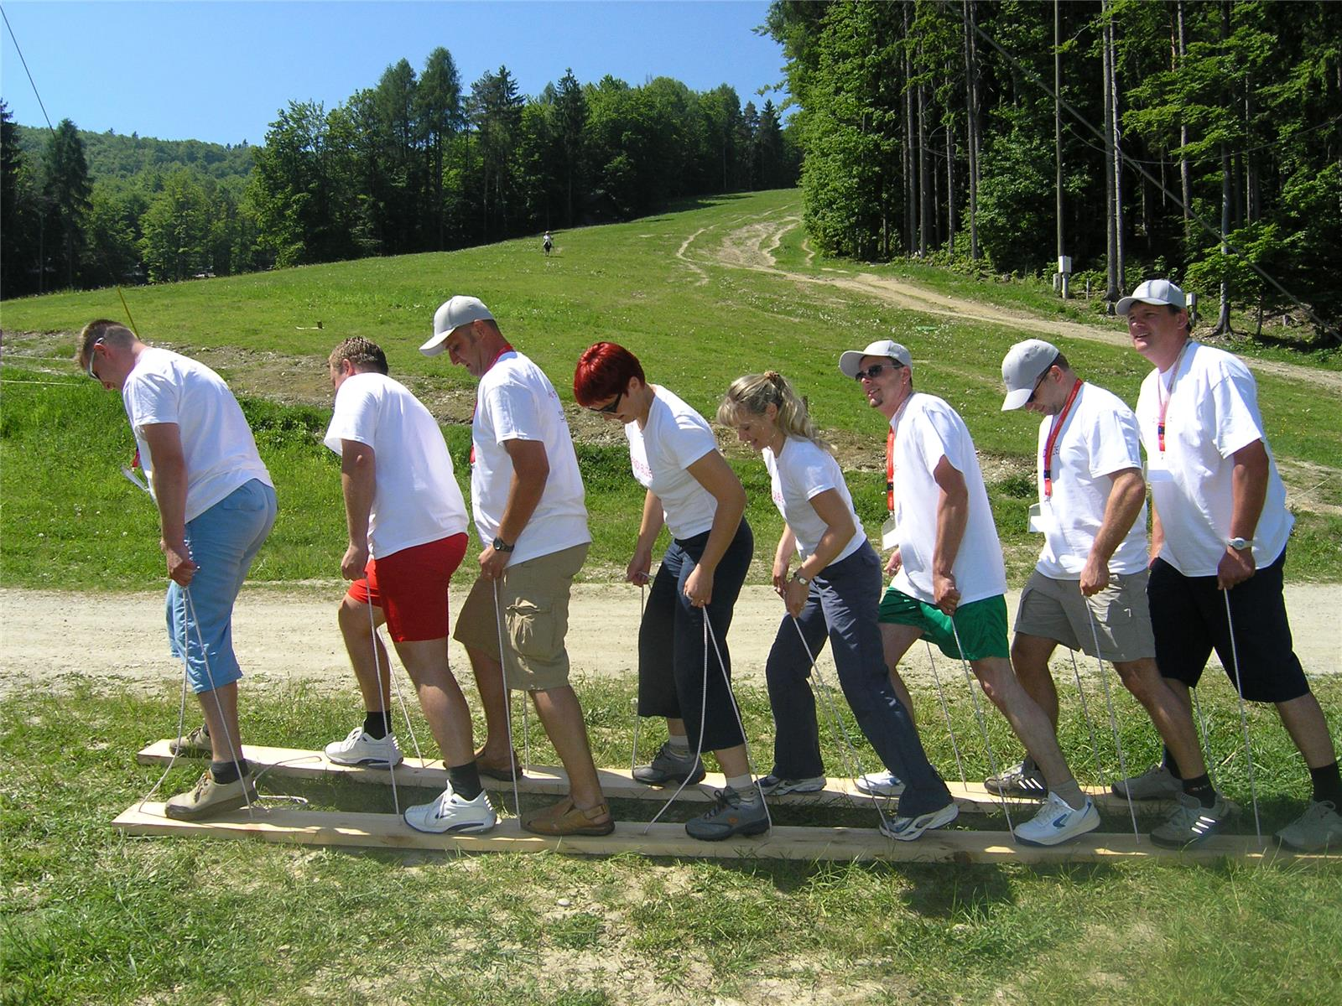
Wouldn’t you like to be a part of that kind of society?
Wouldn’t you like to be a part of that kind of society?

