Slide 1
The risen Jesus 4
John 20:24-31 Life for the sceptical

Slide 2
When you miss out

Slide 3
God’s timing is not our timing
A whole week goes by
Thomas the realist
Thomas the person who likes plain speaking
God let Thomas think wrongly for a whole week
In doing that Thomas becomes the champion of everyone who struggles to believe

Slide 4
God hears everything
Thomas spoke the words to the other disciples but Jesus answers him when He appears
Jesus was doing what we know God does

Slide 5
Jesus speaks peace
‘Peace’ a blessing
Peace is not just the absence of strife, but a positive presence that adds to our sense of wholeness and breeds contentment
Peace is to all

Slide 6
Jesus answers the most important questions
Thomas needed more
The more you need, the more will be expected of you as a response
Others need less
And God will make them happy and content and whole as they accept Jesus

Slide 7
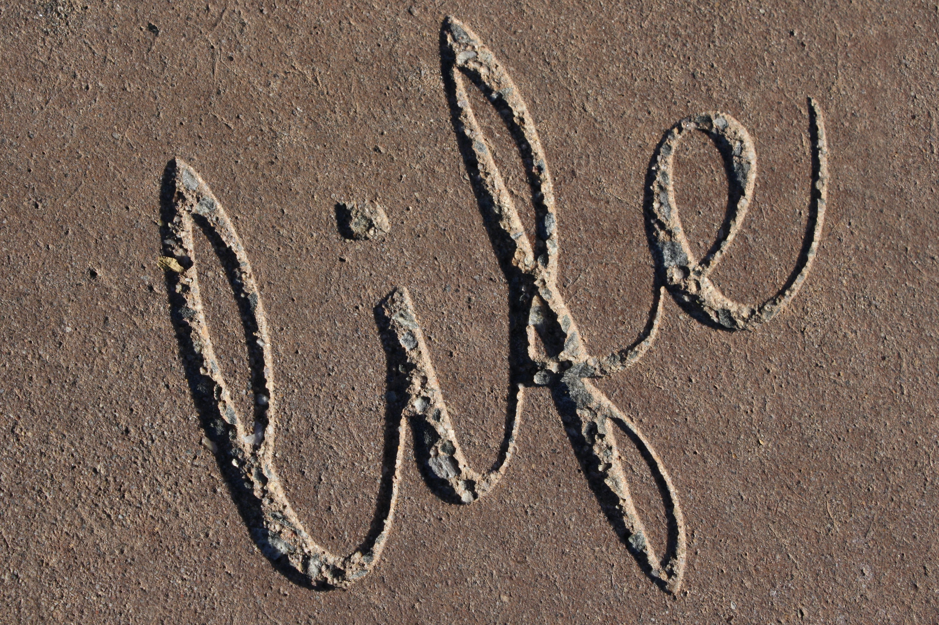
God’s call is for you to have life
John has written all these things, and left more out, so that the reader might believe and have life
What else do you need to come to faith?

Slide 8
Jesus is risen
A truth worth believing
A truth worth living for
A truth worth dying for
A truth worth exploring

