Slide 1
Sealing the Covenant
2. Deuteronomy 27:1-8 Keep your part

Slide 2
The Deal
God had rescued them and led them to the Promised Land
They are about to enter and there’s been a declaration that God’s people would do things together with God (26:16-19)
A reminder about priorities
But here we have a call to worship as soon as they get there

Slide 3
God keeps His promises
A promise about the Land: fulfilled
Other promises made to them
A Messiah would come
Promises made to us through Christ
Our sins would be paid for
The Holy Spirit would be given to all of God’s people
We will walk with God forever

Slide 4
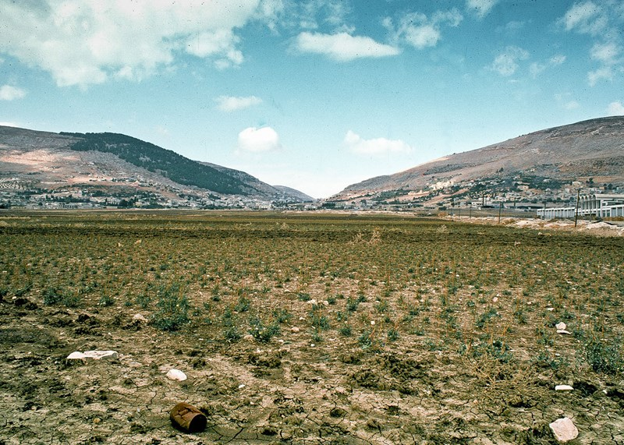
God’s gift is a good gift
A land flowing with milk and honey
It didn’t look like it from where they were standing
Some are wary of God’s gifts
It’s not about the Land, it’s about the travelling companion!

Slide 5
God’s Law is for God’s people in all circumstances
The whole of the Law = The 10 Commandments
The details of how this is applied is just for clarity in Ch 12-26
How you honour God (Commandments 1-4)
How you celebrate together (4,5)
How you do responsible leadership (1-10)
How you handle accidents (8-10)
How you conduct yourself in battle (6)
How you deal with families in need (6-10)
How you love your neighbour (6-10)
How you show love (1-10)
How you give every person their basic rights (6-10)
Written publicly for all to see
Written clearly for all to read
Written on hard clay as a reliable witness
Written as a command to follow

Slide 6
Gerizim (blessing)
Ebal (cursing)
Shechem

Slide 7
God’s people: Connected to God
Before you start the campaign – listen to God
When you start the campaign – worship God
When you claim your first hill – celebrate with God
Worship with burnt offerings
Worship with fellowship offerings

