Slide 1
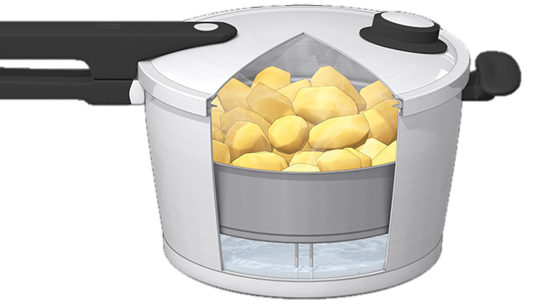
Faith in the Pressure Cooker
The Letter Of James
11 It’s in the small things
4:10-17
Faith

Slide 2
James
To isolated scattered Christians:
Trials and temptations
Listening to God
Doing what He says
Pure religion is shown in
Buttoning the lip
Looking after the vulnerable
Keeping your conscience clean before God
How we treat each other
NO favouritism
Faith and deeds
The tongue
The Hope: God’s wisdom is available to help you get it right
The promise: If you do humble submission ‘God will raise you up’ (4:10)

Slide 3
You have accepted Christ
Humility is less about what you do and more about how you do it, says James
Let Him in to your decision making
Let Him in to your attitudes
Let Him in to your values

Slide 4
Let Christ in
Let Him in to your treatment of others
Especially those who are close
Let Him in to the planning of your life and make room for heaven’s interventions
God knows what He is doing!
Let Him in to the daily decisions
These are the ‘little things’ James talks of in this section

Slide 5
He transforms best in the pressure cooker
He is full of compassion and mercy
Mrs SA Ducker

Slide 6
Challenge
Before you react to a disappointment this week remind yourself:
God knows what He is doing
God is in charge
THEN pray!

