Slide 1
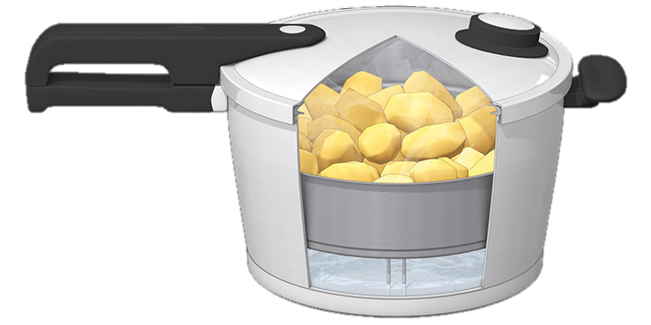
Faith in the Pressure Cooker
Faith
The Letter Of James
2 Your attitude is key!
1:2-11

Slide 2
The pressure cooker
The pressure cooker is the place where things get done quickly
It’s where you feel the impact of every decision and you don’t have the luxury of time
It’s where the difference between undercooked, perfect and overcooked is measured in seconds and blowing a gasket can happen often

Slide 3
Tools for the pressure cooker
Marriage preparation
How to communicate with a goal of intimacy
How to support each other by knowing their own personality and that of their partner
How to maintain their vision
James is giving similar tools to the scattered isolated Christians for their witness

Slide 4
Is James nuts???
Count trials a joy?
He’s wanting you to see the bigger picture of life so that you can get a faith perspective

Slide 5
God wants you to be fully mature by the time you get to heaven
So that you can fully enjoy His glory
So that you can fully enjoy being in His presence
If you went at your own pace you would not get there
So God sets the pace for you
He wants you there fully mature, wholesome and lacking nothing

Slide 6
Faith

Slide 7
Tools for the journey of faith
The wisdom of God
Something beyond yourself from a perspective you miss

Slide 8
God gives wisdom to those who want to move on
If you think staying where you are is still an option then you don’t need His wisdom
Doubt happens when you forget where you’re going!
God wants you to get the crown of life

Slide 9
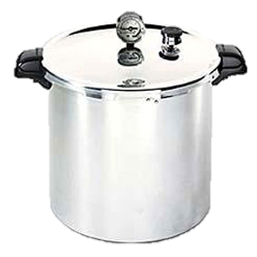
This week’s challenge
Once a day try a change of attitude to see if it produces a different outcome
You may want to give someone permission to challenge you once per day

