Slide 1
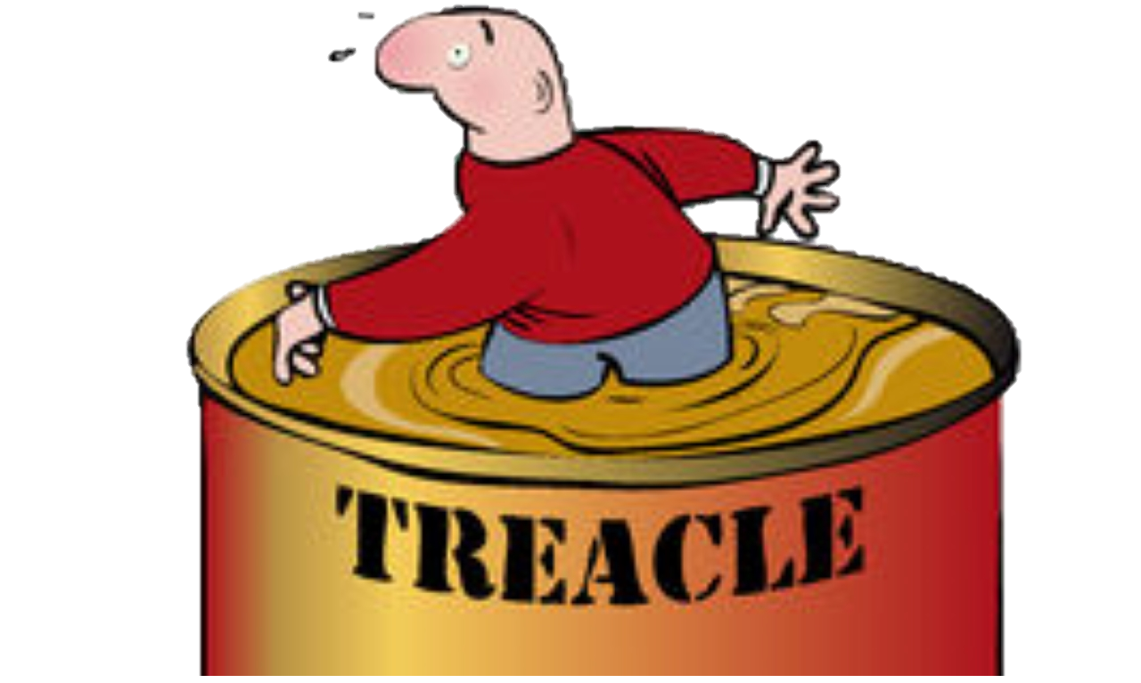
Walking through treacle
5. Respect your detractors 2 Cor 2:14-3:6
2 Corinthians 2:3-17

Slide 2
Doing things differently
If you find some new way of doing things and you pursue it there will always be people who will stand back and shake their heads
The next big section of 2 Corinthians (2:14-7:4) is about serving in the New Covenant
Paul is being attacked for changing the ground rules for acceptable practices in the church

Slide 3
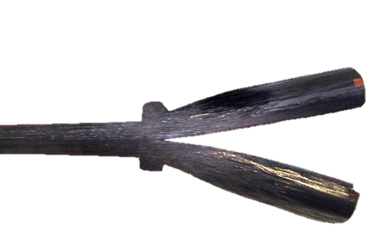
God has made a NEW covenant
A new agreement between Himself and human beings
Using the Old Covenant to make people acceptable as family members cannot work under the new covenant
Even though the standards in the two are the same
How do we commend ourselves in this covenant?
We don’t, God does
We don’t, you do
The greatest commendation of any leader is what God thinks of them and what is achieved

Slide 4
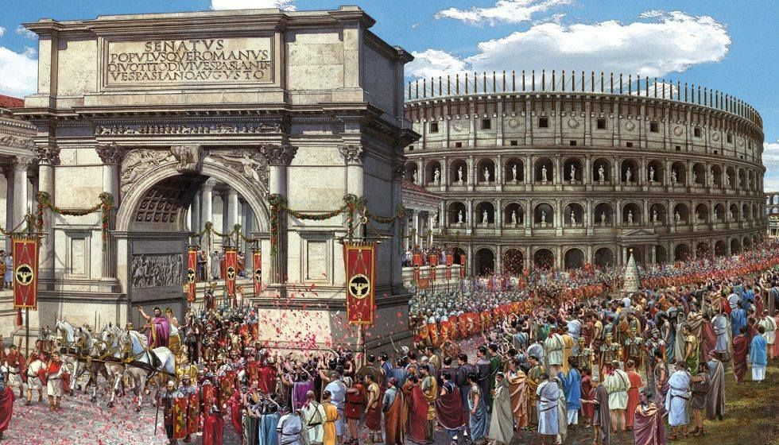
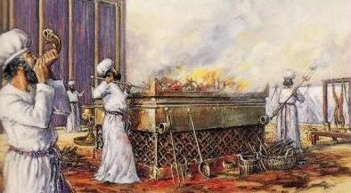
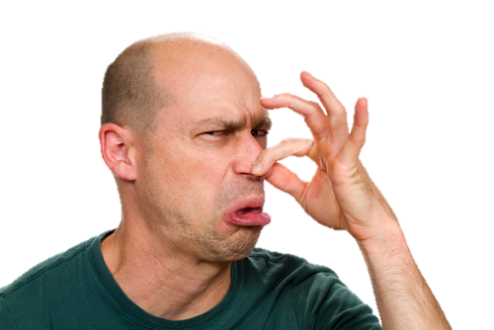
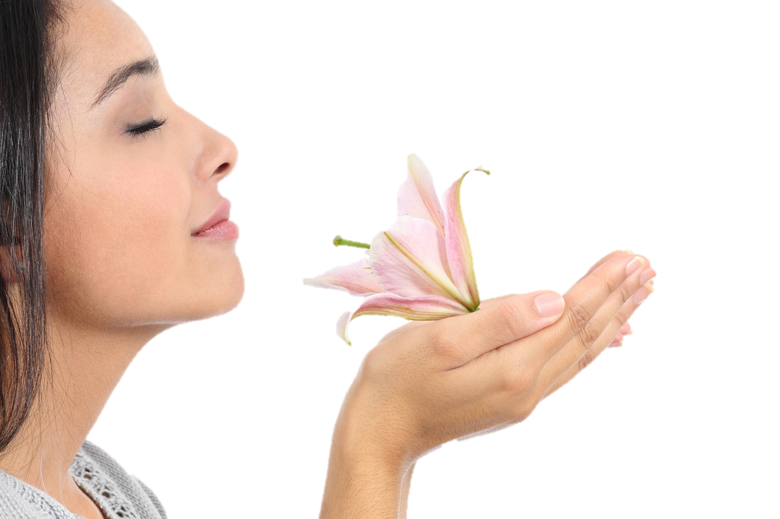
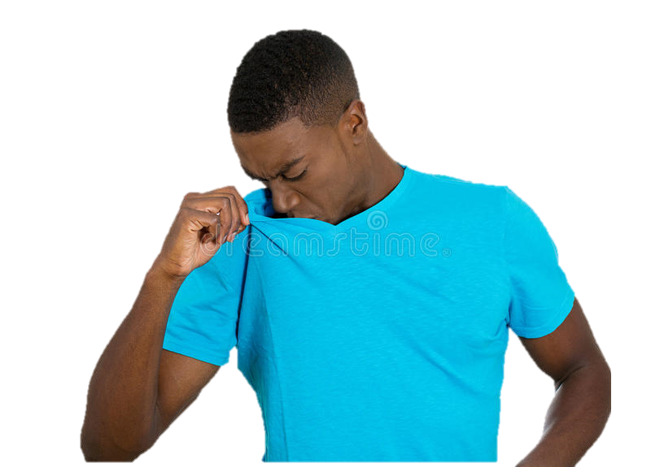
God likes the way you smell
You exude thanksgiving and grace
The fragrance of God’s grace spreads from you
But not everyone likes your aroma!

Slide 5
God wants you to be Spirit led
Not just when He anoints you, but when he teaches you the difference between the spirit of the Law and the letter of the Law
The breath of God (pneuma) is more valuable in shaping you than the written word (gramma)
Paul was still led by God despite the lack of success as the Judaizers measured it
The Spirit of God enabled him

